Slide 1
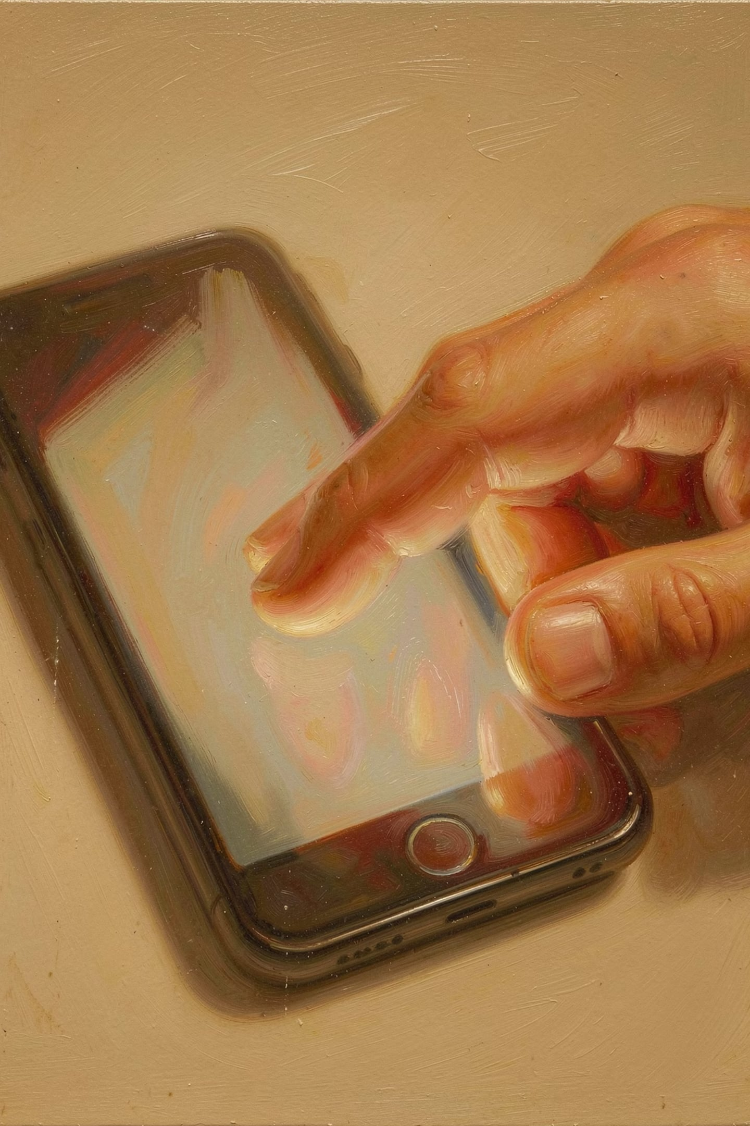
Touch-Based User Interfaces
A. Lesson Preview / Review
In the previous module, we identified handheld and wearable devices. Below are common examples and uses:
Handheld Devices Uses
Task-based processing, portable computing, web browsing, and on-the-go communications.
Wearable Devices Uses
Continuous health metrics monitoring, biometric feedback, and notification synchronization.

Slide 2


B. Main Lesson
1. Touch User Interface (TUI) / Touch-Based Interface
Definition
Contrast with GUI
A computer-pointing technology based upon the sense of touch (haptics).
Whereas a Graphical User Interface (GUI) relies primarily upon the sense of sight, a TUI relies upon the sense of touch to innervate and activate computer-based functions.
Accessibility Benefit
Historical Milestone
It provides an added level of interaction based upon tactile or Braille input, making it highly beneficial for users with visual impairments.
While early touch-based concepts trace back to the 1960s, mainstream market exposure spiked in 2007 with the launch of the Microsoft Surface and the Apple iPhone, initiating the modern era of multi-touch consumer products.

Slide 3

2. Design Considerations for Touchscreen Gadgets
Touchscreen gadgets are highly customizable, permitting designers to craft a wide range of user experiences. When designing touch-based user interfaces, developers must utilize available benchmarks and directives:
1
Extension of the Body
The device interface should feel like a natural extension of the user's body (Wigdor & Wixon, 2011).
2
Natural Experience
Offer an intuitive, natural interaction style that allows users to operate systems directly.
3
Immediate Feedback
Permit the systems to immediately display the outcomes of the user's touch and movement direction.
4
Size Factor
Carefully account for the size factor of touch targets to ensure reliable selections.

Slide 4
3. Core Interaction Techniques
Tapping-it
Crossing-in
Directional Gesturing-it
The most common gesture technique. It involves choosing a digital item by briefly touching it.
An alternative method where an intended target is chosen by dragging across or crossing it. This offers improved target selection and usability performance for motor-impaired individuals.
The only technique that eliminates the strict requirement for predefined target selection spaces, as directional gesture movements can be performed anywhere across the device surface.

Slide 5
C. Core Touchscreen Technologies
1. Wire Resistive Touchscreens
Composed of a glass base panel and film screen layer, each covered with a thin metallic layer separated by a narrow space. Touch pressure forces the layers to make contact, changing the voltage flow to locate the touch point.
Advantages
Disadvantages
Can be activated with virtually any input object (bare finger, stylus, gloved hand, pen, etc.).
Provides distinct tactile feel.
Highly cost-effective touch solution.
Consumes low power.
Resistant to surface contaminants like dust, oil, grease, moisture, and liquids.
Lower overall image definition compared to rival touch methodologies.
Outer polyester layer is highly vulnerable to damage from scratches, poking, or sharp objects.

Slide 6
2. Surface Capacitive Touchscreens
Features a transparent electrode layer placed directly on a glass substrate panel, protected under a specialized covering layer. It reacts to the static electrical capacity of the human body, drawing electrical charges from the four corner sensors to calculate the exact touch point coordinate.
Advantages
Disadvantages
Offers superior image clarity compared to resistive modules.
Durable screen integration.
Can strictly only be activated by human skin contact or an specialized electrical stylus.

Slide 7
3. Projected Capacitive Touchscreens
Similar to surface capacitive systems but offers two primary advantages: it can be activated with thin surgical or cotton gloves and enables multi-touch activation (simultaneous inputs from multiple fingers). It uses a sheet of glass integrated with embedded transparent electrode films and an Integrated Circuit (IC) chip to detect touch point ratios via a 3D electrostatic field.
Advantages
Disadvantages
Excellent image clarity.
High resistance to surface scratches.
Resilient against liquids and surface contaminants (dust, oil, grease, moisture).
Full multi-touch support.
Requires a bare finger or a specialized capacitive stylus for proper activation.
Susceptible to Electro-Magnetic Interference (EMI) and Radio Frequency Interference (RFI).

Slide 8

4. Surface Acoustic Wave (SAW) Touchscreens
Utilizes an invisible grid of ultrasonic wave transducers and receivers running along the outer edges of a monitor's glass panel. Pressing the glass absorbs a portion of the clean ultrasonic wave grid, allowing the tracking system to parse the coordinate location and transmit the data.
Advantages
Disadvantages
Excellent image clarity and light transmission.
High resistance to surface scratches.
Supports multi-touch capabilities.
Must be activated via an exposed bare finger, thin surgical glove, or soft cotton glove.
Highly sensitive to environmental EMI and RFI interference.

Slide 9
5. Infrared Touch (IR) Touchscreens
Does not overlay the display screen with an additional glass layer or material sandwich. Instead, it positions infrared light emitters and sensors around the outer frame to create an invisible grid of light beams. Any physical object interrupting the light beam grid allows sensors to accurately map the location.
Advantages
Disadvantages
Highest possible image clarity and light transmission across all screen technologies.
Infinite "touch-life" durability.
Impervious to superficial surface scratches.
Exceptional scratch resistance compared to capacitive touchscreens.
Will not activate with hard items like a hard plastic pen, credit cards, or fingernails.
Water droplets or solid contaminants resting on the screen can block beams and cause false touch triggering.
Accidental activation can occur because the infrared beams reside slightly above the physical glass surface.
Sensitive to snow, rain, or severe ambient light interference.
Higher cost of integration compared to alternative architectures.

Slide 10

Recap
Touch User Interfaces (TUI)
Four design considerations for touchscreen gadgets
Three core interaction techniques
Five touchscreen technologies covered
Choosing the right touchscreen technology

